Slide 1

Don’t Forget
Please sign in on the app – whether you are in person or online
If you are in the room, please wipe down your workspace both before and after the session using the wipes provided

Slide 2

BS1220: Introduction to Software Design and Development
Hybrid Session 1

Slide 3
3.6: This session
Content for the Week
Key Terminology Definitions
Defining Functions
Return Statement

Slide 4
Sessions This Week
Defining Functions
Defining Functions with Return statements
Defining Functions with Varying Numbers of Parameters
Different Types of Parameters

Slide 5
Recap – Key Definitions
In your groups, come together to discuss your definitions for the keywords identified in 3.3 (pre-session content)
Once you have agreed your definitions, one member of the group should add the definition to the Padlet

Slide 6
3.7: Defining Functions
def function_name():
#code for function to run
function_name()

Slide 7

Demo 1
Hello World Function

Slide 8
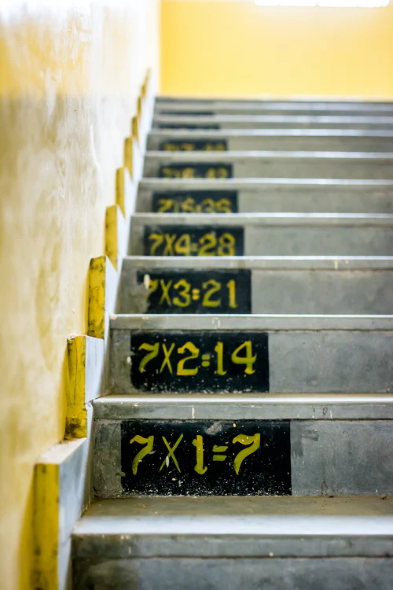
Demo 2 Scenario
You need to write a program which takes in four numbers from the user, multiplies them together, and prints the answer

Slide 9

Task 1 – WRITE THE PSEUDOCode

Slide 10
PSEUDOCODE
OUTPUT enter first number
INPUT number entered by user
ASSIGN to variable (num_1)
OUTPUT enter second number
INPUT number entered by user
ASSIGN to variable (num_2)
OUTPUT enter third number
INPUT number entered by user
ASSIGN to variable (num_3)
OUTPUT enter fourth number
INPUT number entered by user
ASSIGN to variable (num_4)
CALCULATE num_1 * num_2 * num_3 * num_4
ASSIGN to variable (product)
OUTPUT product

Slide 11

Demo

Slide 12

PRACTICE
There is a worksheet available in the Teams channel for you to start working through to practice defining functions
Make sure you download a copy – DO NOT JUST USE THE ONE ONLINE
We will complete a walkthrough of one of the questions after you have had some time to practice

Slide 13
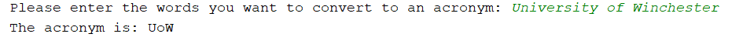
Question 2
Write a function (called acronym_generator()) which takes in a line of text from the user (you can assume that the user will enter 3 words). The program should then output the acronym for the 3 words (the first letter of each word). For example:

Slide 14

Pseudocode
OUTPUT enter words to be made into acronym
INPUT words entered by user
ASSIGN to variable (acronym_string)
SPLIT sentence into separate words
ACCESS first letter of first word
ASSIGN to variable (first_letter)
ACCESS first letter of second word
ASSIGN to variable (second_letter)
ACCESS first letter of third word
ASSIGN to variable (third_letter)
CONCATENATE three letters
ASSIGN to variable (acronym)
OUTPUT acronym

Slide 15
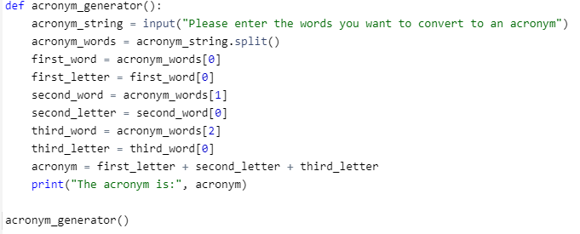

Slide 16
3.8: Return Statement
Special statement
Ends the execution of a function
Returns control to calling function
Can pass values back to the calling function

Slide 17

Demo – Using the RETURN statement

